Slide 1
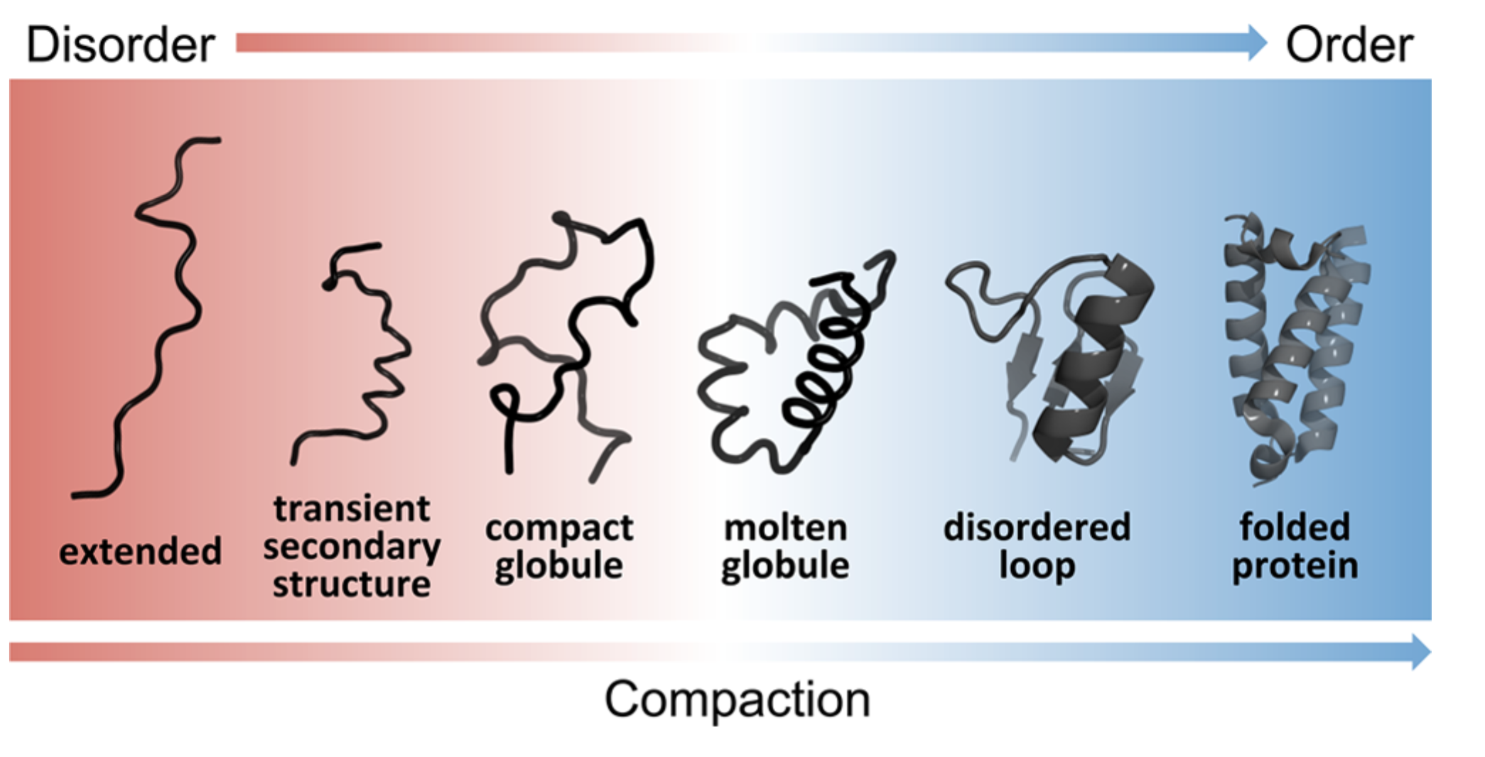
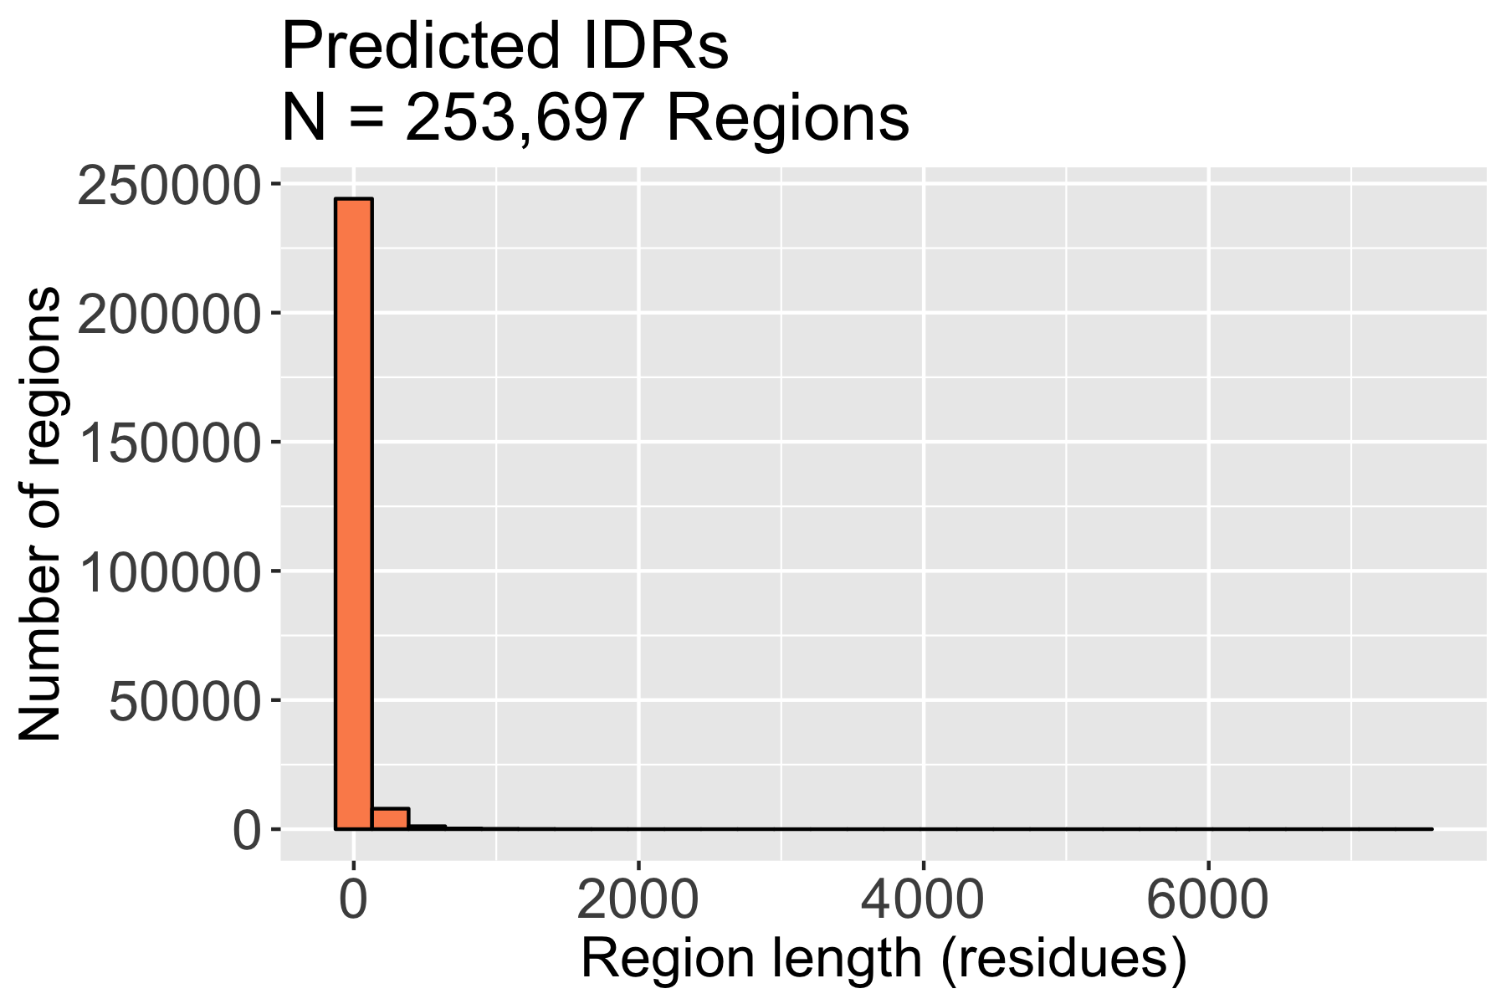
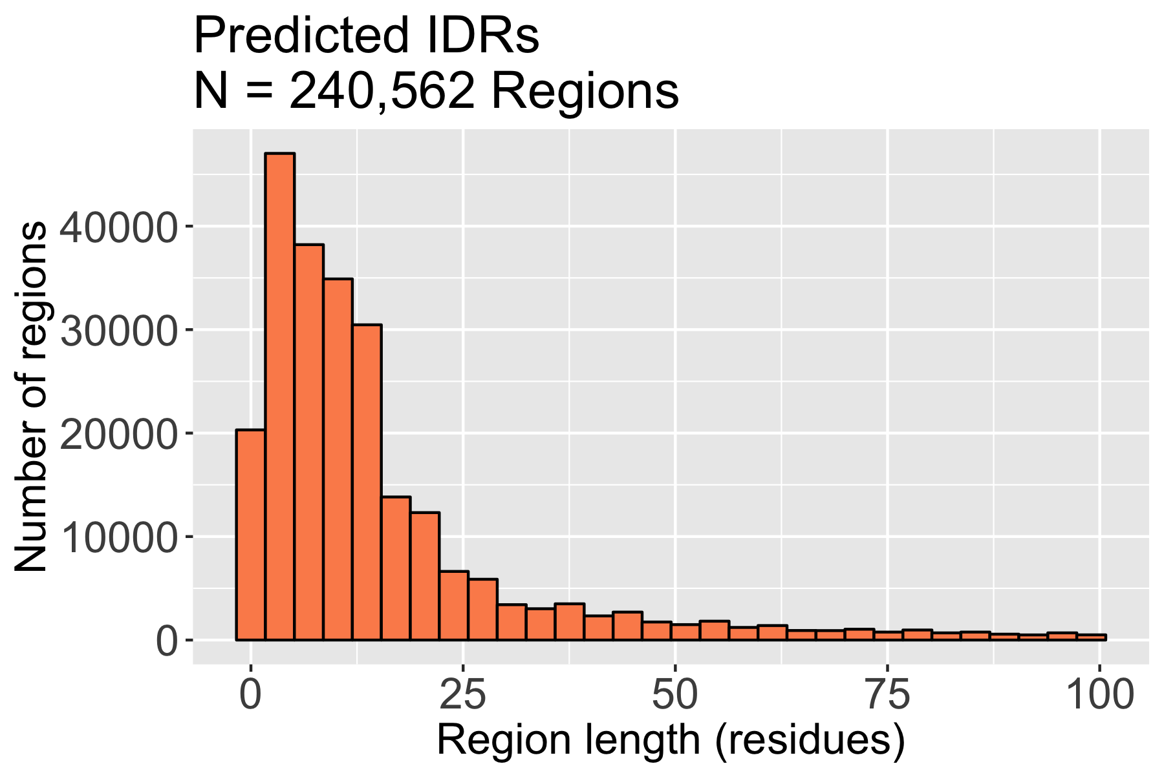
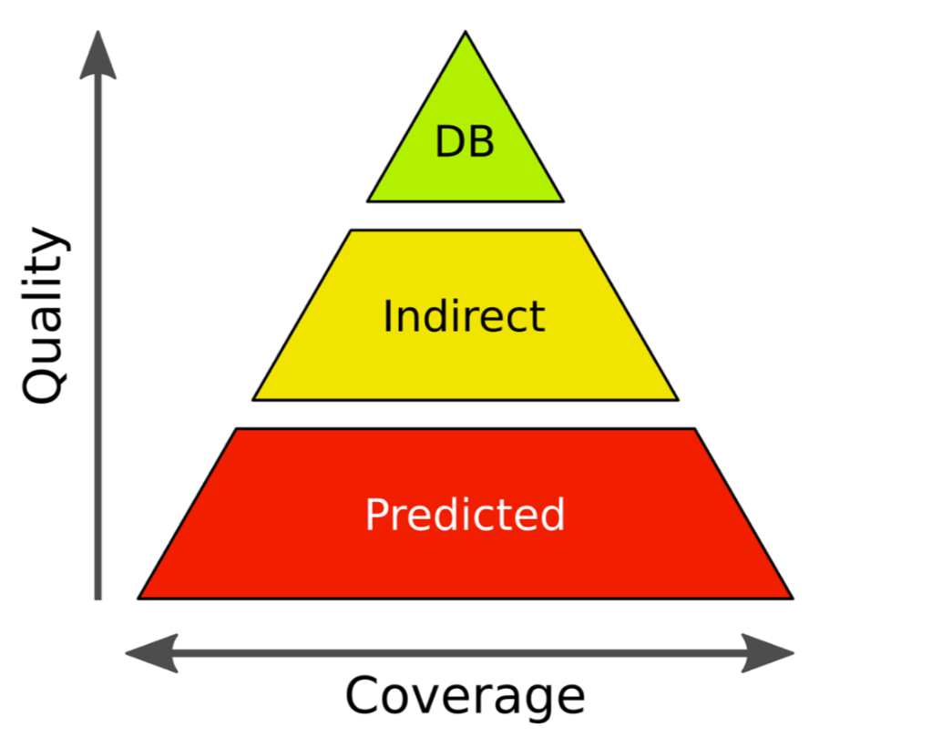
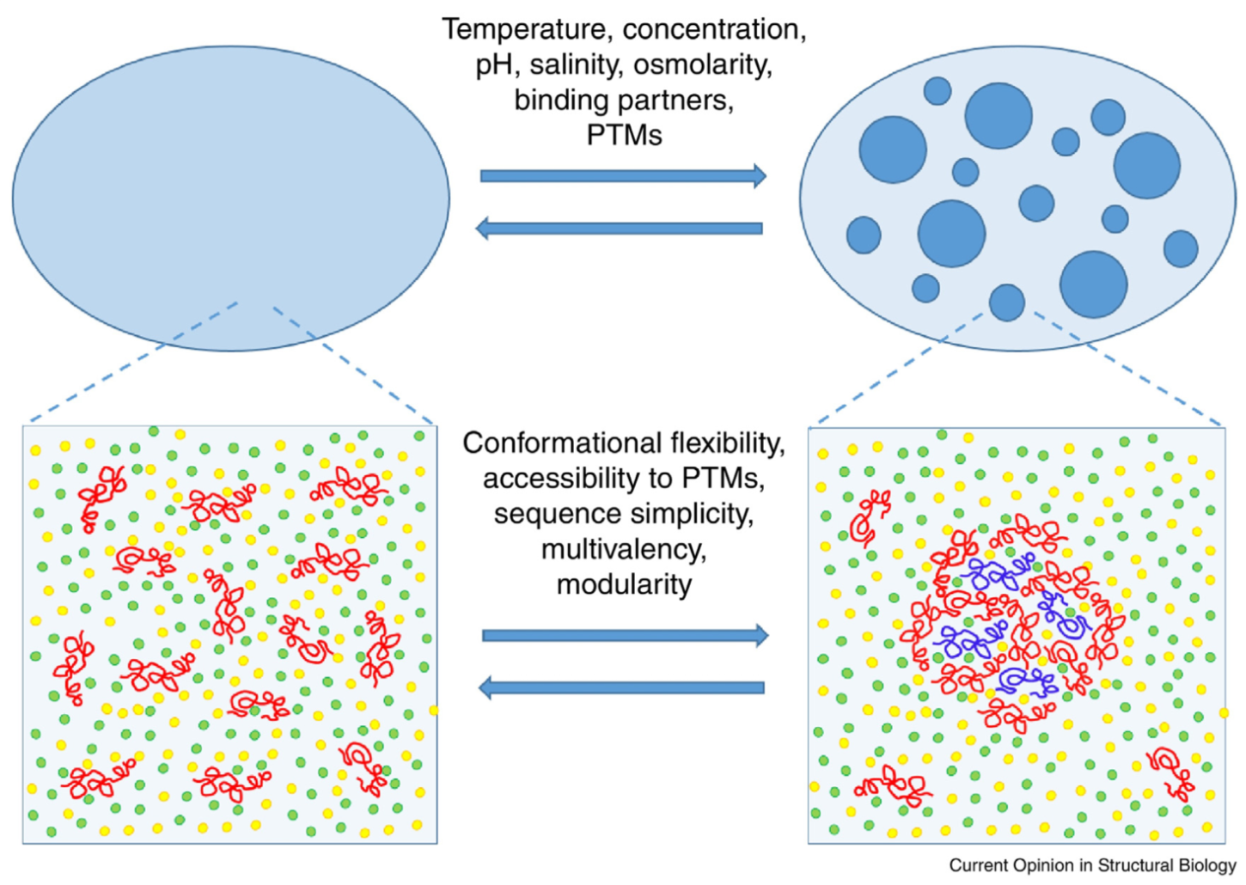
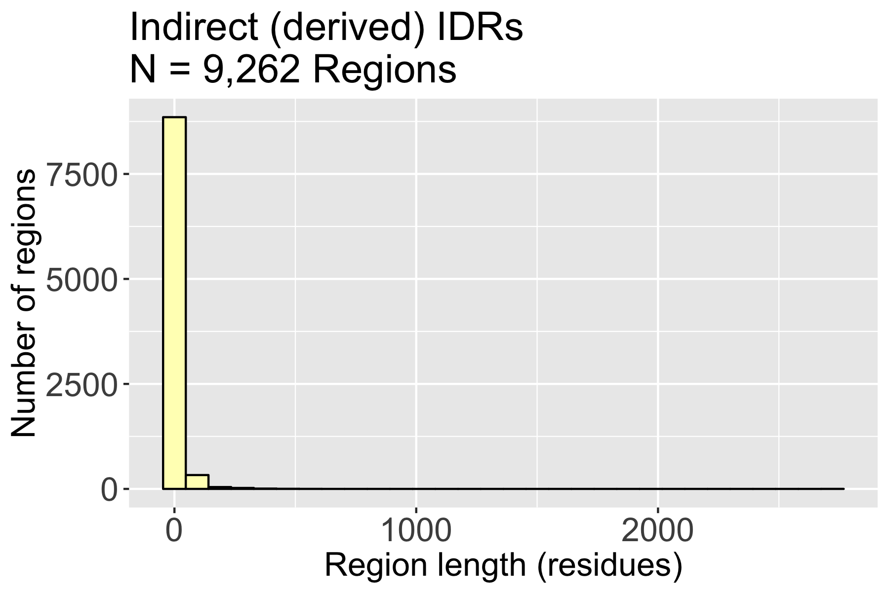
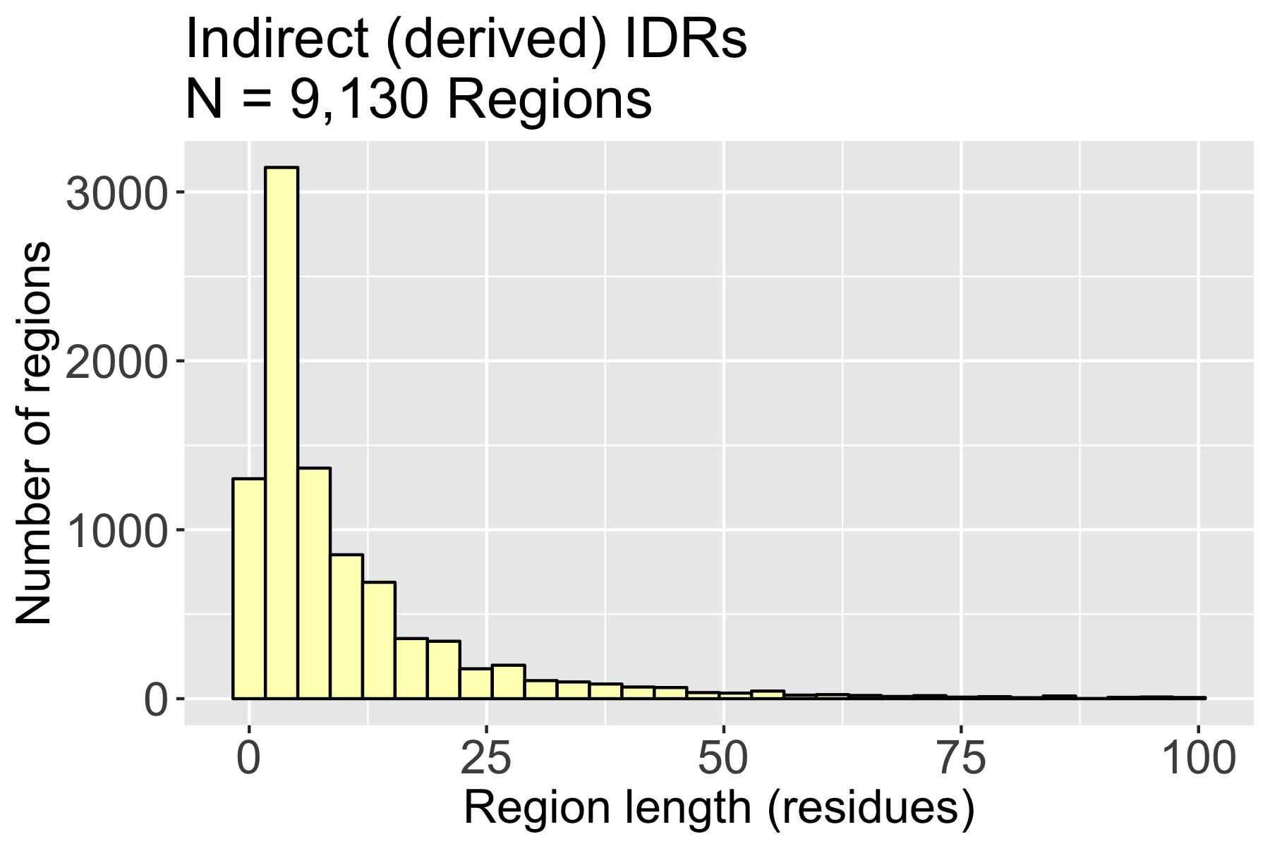
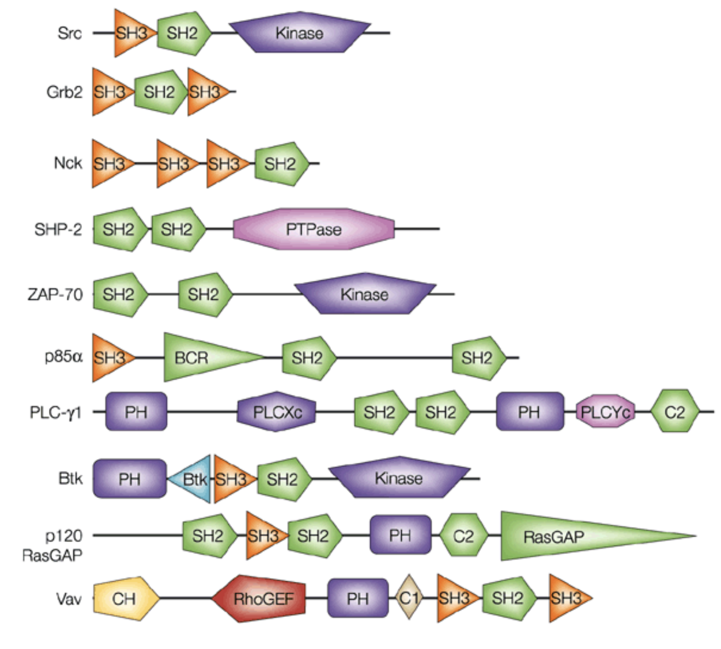
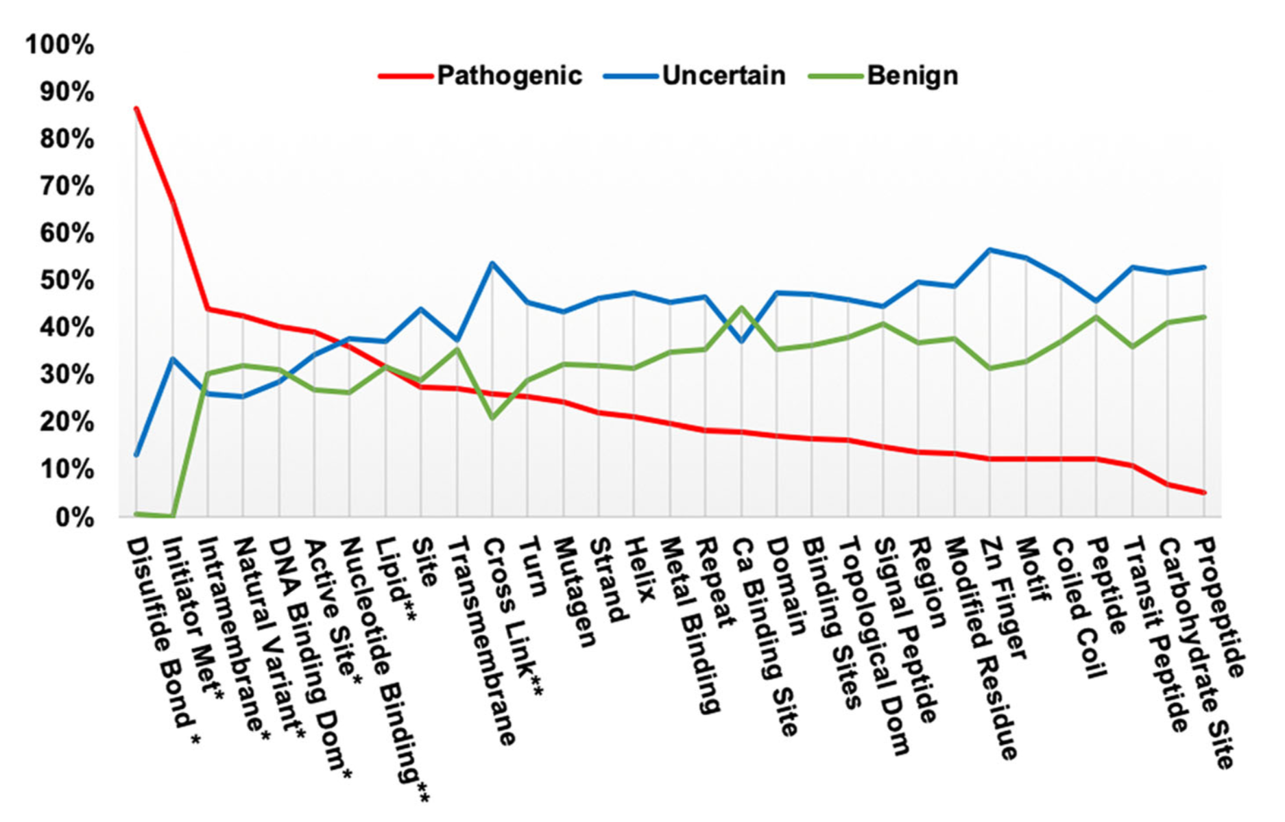
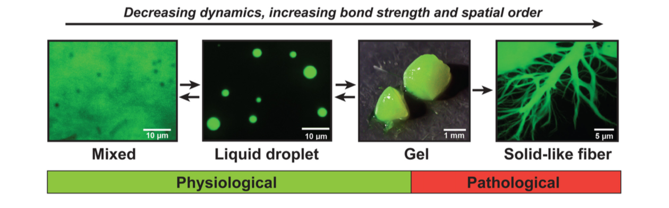
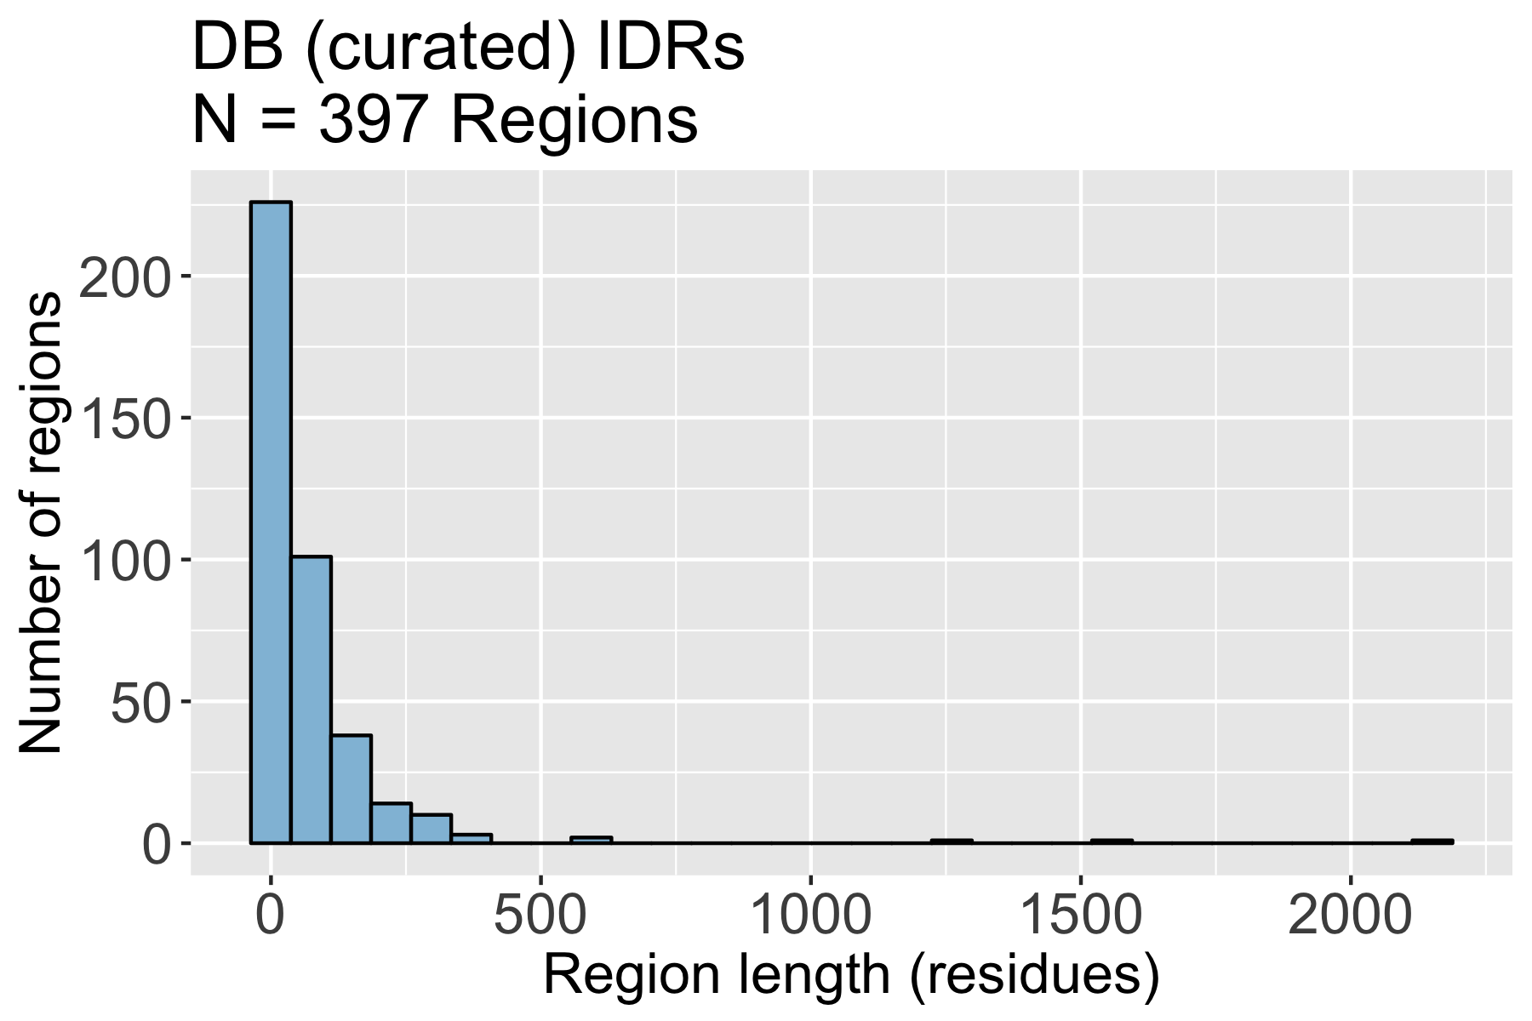
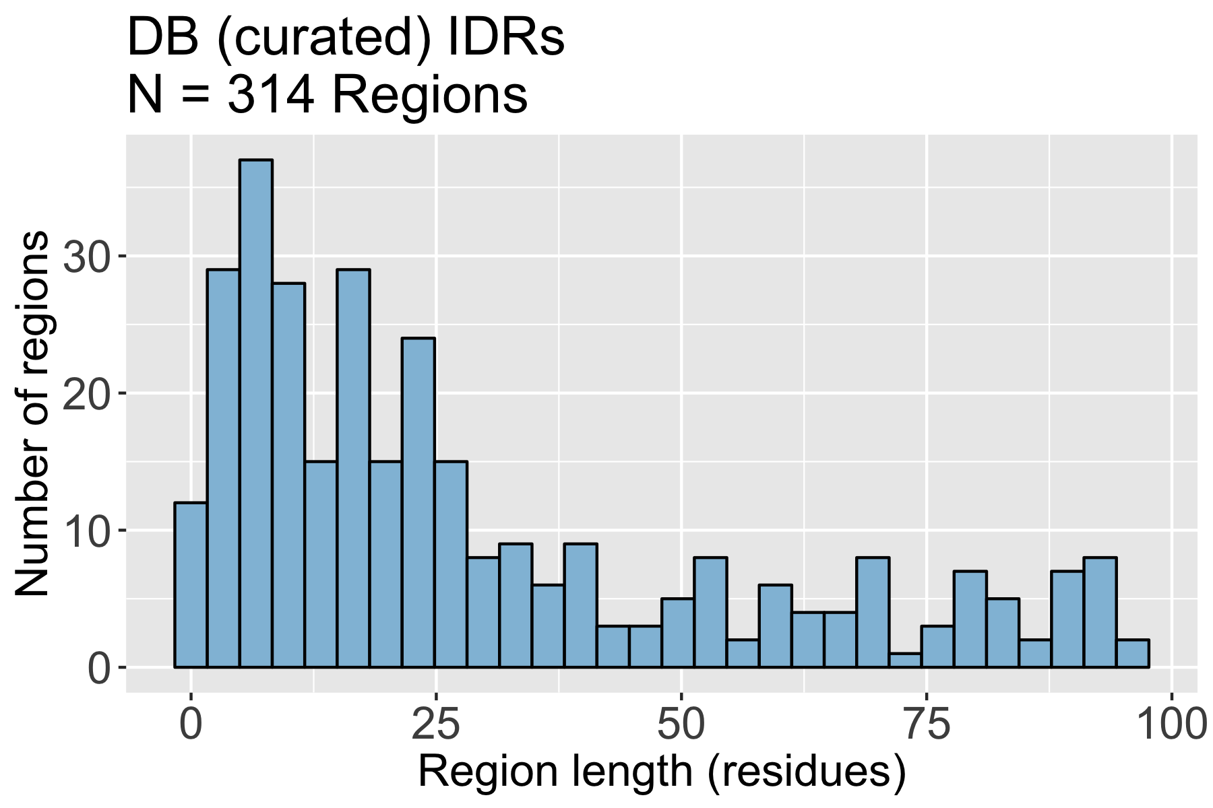
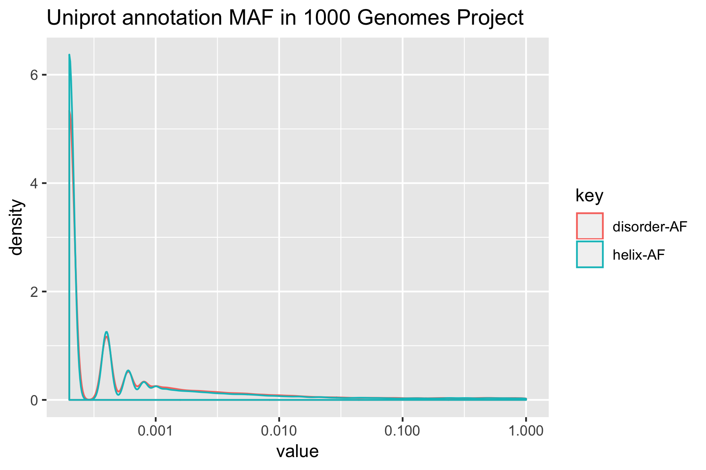
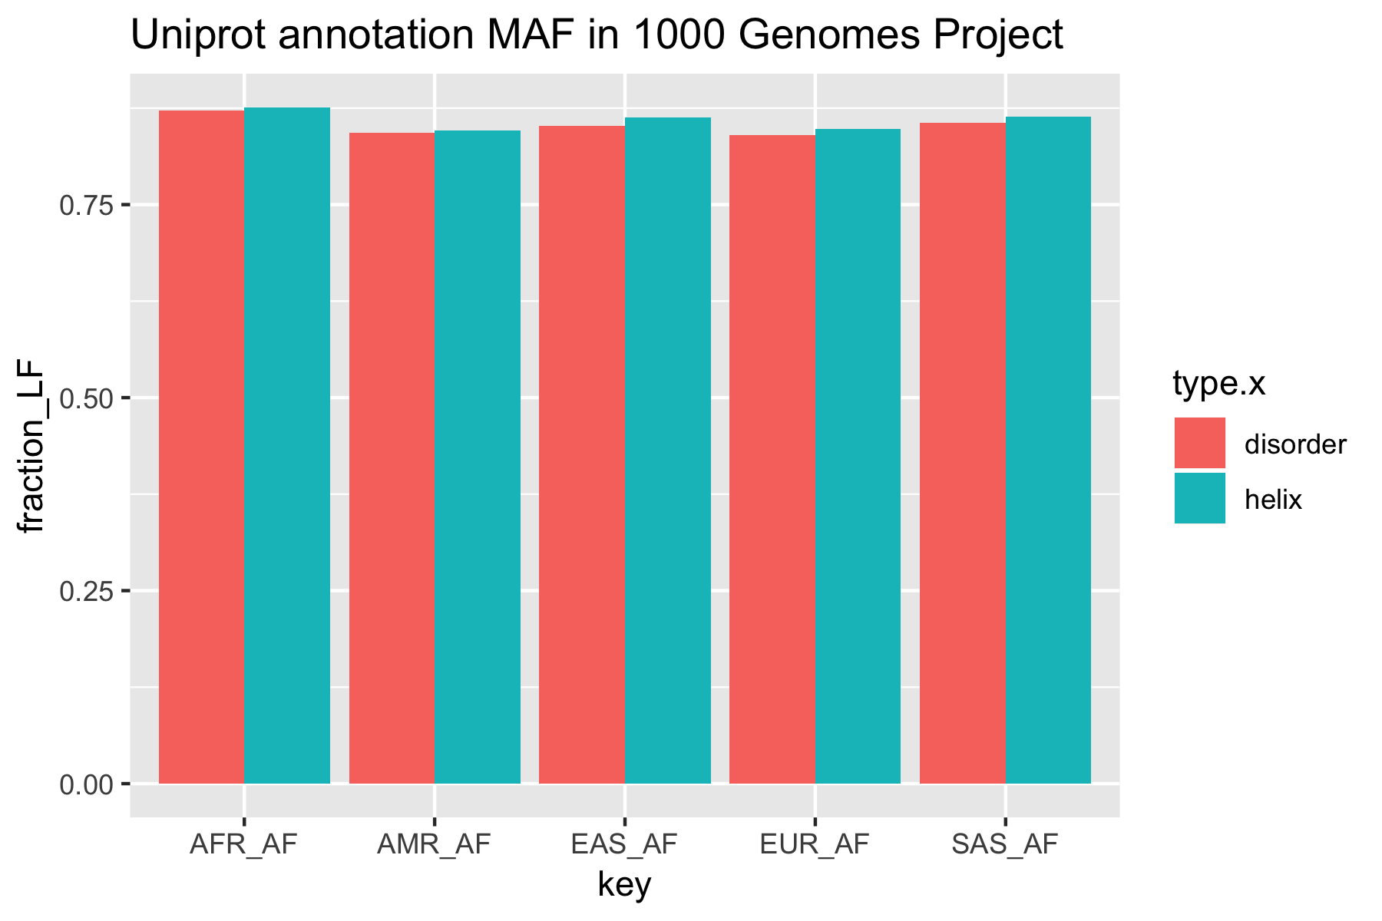
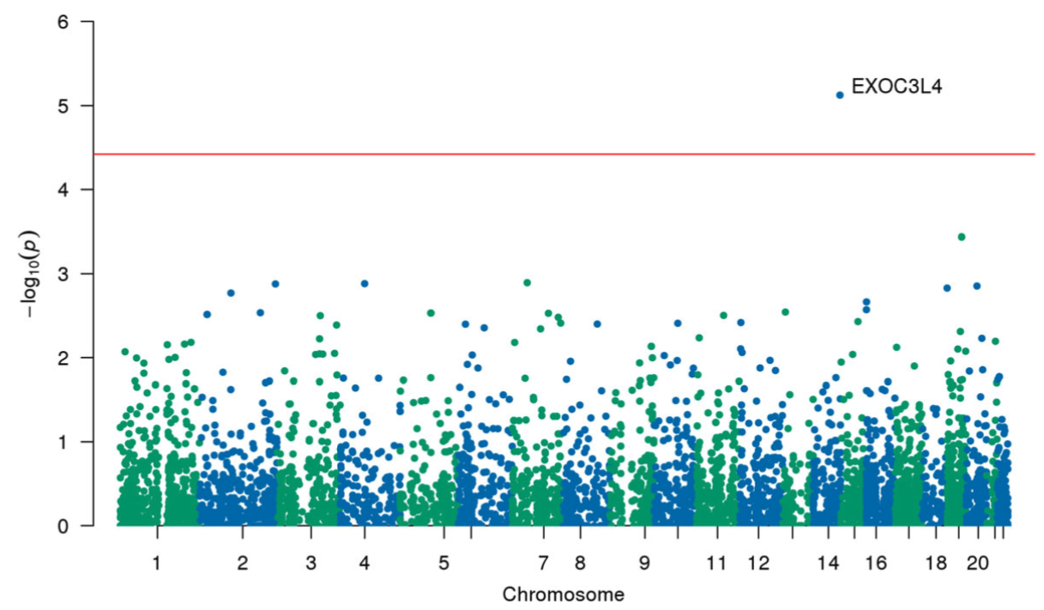




Quantifying genetic and phenotypic variability
associated with protein features
Jason E. Miller, Scott M. Dudek, Alex T. Frase, Theodore Drivas, and Marylyn D. Ritchie
Department of Genetics, Institute for Biomedical Informatics, University of Pennsylvania, Philadelphia, PA, USA
Question: how are intrinsically disordered proteins linked to Alzheimer’s disease?
Overview of MobiDB:
a comprehensive database of IDR annotations
Characterizing disordered regions
using the MobiDB database
Intrinsically disordered proteins (IDPs) are functional even though they are unable to fold into a stable conformation. They are important for regulating many cellular processes including transcription, translation, and cellular signaling.
MobiDB is a database that contains three broad types of IDR information.
All Regions
Regions < 100 residues long
DB: manually curated structural information from databases containing experimental results (e.g. DisProt, FuzDB, and UniProt).
Indirect: information derived from PDB data using missing residues, high temperature residues (X-ray), and mobility (NMR).
Predicted: disorder prediction algorithms that use amino acid sequence information.
Lee, Chem. Rev., 2013
Intrinsically disordered regions (IDRs) (often in tandem with structured regions) give proteins the ability to generate membrane-less organelles to localize biochemical processes in a process referred to as liquid-liquid phase separation.
Piovesan et al., Nucleic Acids Research, 2018
Uversky, Current opinion in Structural Biology, 2017
UniProt database contains genomics coordinates for structured domains
and some IDRs.
The natural ability of IDRs to mediate interactions with other proteins and generate phase transitions also underlies its connection to protein aggregation in multiple forms of neurodegeneration, including Alzheimer’s disease.
McGarvey et al., Human Mutation, 2019
McGarvey et al., found multiple protein domain categories where there was an enrichment for pathogenic ClinVar SNPs.
Highlights the utility of investigating within the context of protein features.
Alberti et al., Front Mol. Neurosci., 2017
Yaffee, Nature Reviews Molecular Cell Biology, 2002
Hypothesis: characterizing genetic variation in IDRs and structured domains will lead to the identification of new AD risk loci.
Linking protein regions to DNA coordinates
Utility of characterizing genetic variation
within protein features
Protein IDs were filtered for Swiss-Prot reviewed proteins. All three types of disordered regions have long tails, but are primarily made up of sequences smaller than 100 residues. There are many more predicted regions than derived or curated regions.
Protein annotations
from MobiDB
IDR Transcript ID and
DNA coordinates
Statistical
association test
Overall frequency of variants from 1000 genomes project in protein features.
Percent of low variants across different 1000 genomes ancestries and protein features.
Future Questions
P1: 10-20 AA
P2: 5-20 AA
P3: 102-105 AA
…
TransVar
ENST1 - Chr1: 30-60 bp
ENST2 - Chr15: 15-60 bp
ENST3 - Chr21: 306-315 bp
…
Feature
Feature
How does genetic variation differ in known functional regions of IDRs?
Does the co-occurrence of certain domains impact MAF in IDRs?
Does variation differ between those with/without AD/MCI?
How does genetic variation in IDRs differ in other diseases?
UniProt
genomic
coordinates
Gene/Pathway Bins
(MAF < 0.01)
Density
Fraction with MAF < 0.05
Chr1: 30-60 bp
Chr15: 15-60 bp
Chr21: 306-315 bp
…
Intersect VCF with
IDR coordinates
ANNOVAR
BioBin
Acknowledgments and links
SNV
Frequencies
in features
Minor Allele Frequency (MAF), log10
1000 Genomes Project
Whole-genome
sequencing data
Perform rare variant association tests between AD cases and controls to identifying genes associated to AD through SNVs in their IDRs.
Thank you to the Ritchie Lab for feedback. Funding source: NHGRI T32HG009495-01.
VCF w/
All SNVs
VCF w/
All Exonic SNVs
Characterize SNV
MAF distributions
Miller et al,. BMC Medical Genomics. 2018
Poster/GitHub
Twitter @JEMgenes
Lab Website
Notes:
https://www.the-qrcode-generator.com
1. biology VUCOIS, 2017. Intrinsically disordered proteins in overcrowded milieu: membrane-less organelles, phase separation, and intrinsic disorder. Elsevier
.
2019-07-09_mobidb_analysis_A01

